Slide 1
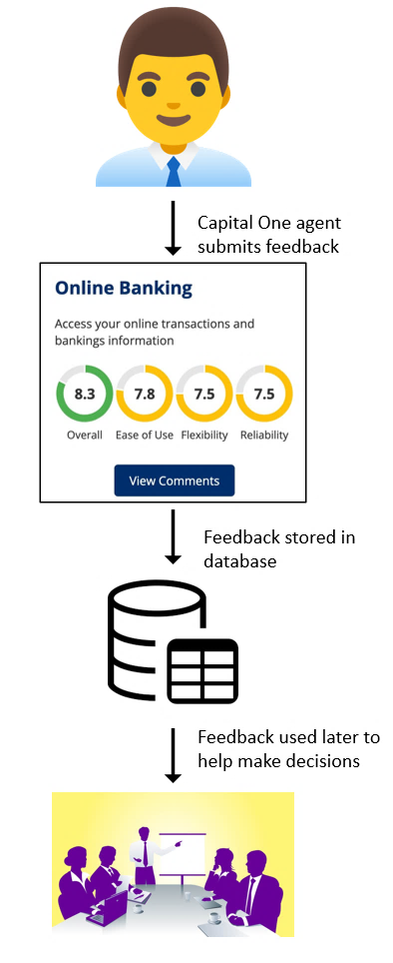
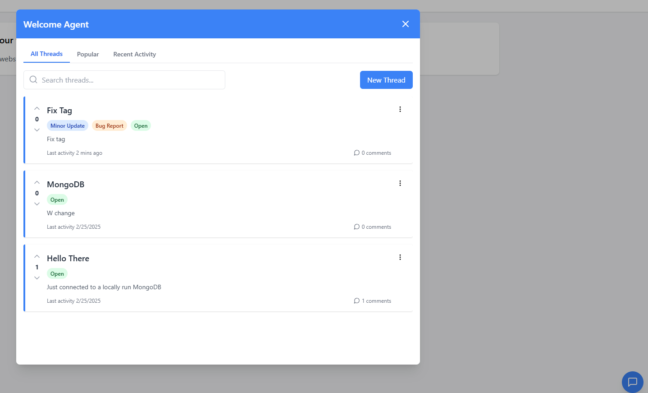
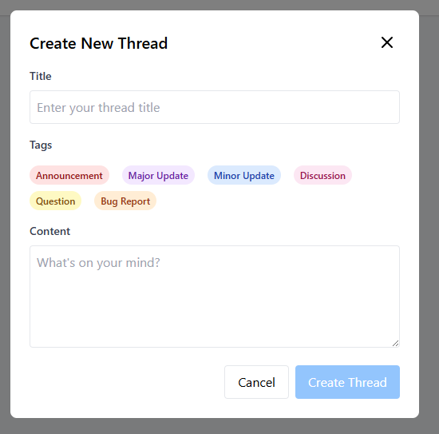





25-323
Modular Feedback
Team members: Ethan Scott, Ahmed Salih, Owen Cupps, Bao Do | Faculty adviser: Hong-Sheng Zhou, Ph.D. | Sponsor: Capital One | Mentors: Zephyr Headley and Mahesh Nair
Problem Statement:
A Challenge faced by development teams is finding a way to gather feature-specific feedback from consumers.
Current methods lack mechanisms that specifically focus on the performance and reception of individual features.
Solution:
To ensure quality feedback, it is essential for us to create a feedback system that encourages users to participate.
Feedback system must be modular and able to be extensible to multiple platforms or products.
By capturing users’ Clickstream data, we can address user concerns more directly.
This would improve customer satisfaction and enhance user engagement with the platform while also providing better feedback data to the teams who will make improvements with it.
Impact:
This impacts product managers, developers, UI teams, and others who rely on actionable feedback to iterate new design features and functionality.
Can result in design decisions that might not be the best fit for a feature.
Constraints:
The system must integrate with Capital One’s Empath system.
Ensures compatibility with existing infrastructure and smooth deployment.
Successful API calls from the feedback system to the Empath platform.
The system backend must be built using a compatible database.
Database must store feedback records without errors, with retrieval times under 100ms for queries involving 1,000+ records.

